Slide 1
Predicting Water Temperature in Ponds Using Machine Learning Random Forest Approach
NAME: PRANESH M
ROLL NO: 23MCA033
PROGRAM: MCA
GUIDE NAME: Dr.S.Nithyanandh Selvam

Slide 2

OVERVIEW
Abstract
Project Introduction
Company Profile
System Specification
Data Collection Method
System Architecture
Methodologies
Future Enhancement
Conclusion

Slide 3
ABSTRACT
Monitoring water quality is vital for optimizing conditions for successful aquaculture, especially when it comes to the cultivation of spirulina.
The primary objective is to create a prediction algorithm that uses past data on water quality to predict temperature changes and provide the ideal conditions for spirulina development.
By improving its real time monitoring and quality assurance procedures, Viridia Biotech can guarantee ideal pond conditions to produce spirulina.
To further improve sustainability and prediction accuracy in spirulina farming, future improvements might include experimenting with sophisticated machine learning algorithms and adding more environmental variables.

Slide 4
Project Introduction
The aim of project is to analyze the maintenance of the aquatic ecosystem by checking the water quality and it also helps us in the temperature prediction by using the random forest regression algorithm.
The goal of Viridia Biotech is to provide ideal circumstances for the production of spirulina, and this research focuses on pond water quality measurement and temperature forecast.
The dataset comprises variables including oxygen dissolved (Net OD), pond depth, pH, salinity, and ambient illumination. By employing a Random Forest Regressor model and doing thorough exploratory data analysis (EDA), the project effectively forecasts trends in water temperature, which contributes to improved automated monitoring and sustainability.

Slide 5
COMPANY PROFILE
At Viridia Biotech, we specialize in cultivating premium organic Spirulina to meet the growing demands of the nutraceutical, food, and feed industries. Established in 2022 and backed by over 12 years of industry expertise, we have quickly earned a reputation for delivering products that combine superior quality, sustainability, and innovation.
Our fully automated production process ensures minimal handling, preserving the purity and freshness of our Spirulina.
MISSION To become a leading global supplier of Spirulina by offering unmatched quality, innovation, and sustainability while fostering trust and long-term partnerships.
VISION To harness the power of Spirulina to enhance health and wellness worldwide while minimizing our environmental impact.
VALUES We strive to produce the most premium Spirulina on the market, adhering to strict quality assurance practices. A research-driven approach ensures we are always finding new ways to improve our products and processes.

Slide 6
SYSTEM SPECIFICATION
HARDWARE SPECIFICATION :
Development Environment
Processor (CPU) : 11th Gen Intel® Core™
RAM : 8 GB
Storage : 512 GB(SSD)
Speed : 2.40GHz
SOFTWARE SPECIFICATION
Operating System : Windows 11 Home Single Language
Language : Python 3.12.1
Develop platform : Visual Studio Code
Packages : Pandas, Seaborn, Matplotlib & Scikit-learn

Slide 7
DATA COLLECTION METHODS
The dataset comprises variables including oxygen dissolved (Net OD), pond depth, pH, salinity, and ambient illumination.
Key water quality parameters that are necessary for the best possible growth of Spirulina are regularly monitored by high-precision sensors placed across various pond locations.
Sensors in the monitoring system continually record data at predetermined intervals (e.g., every 15 minutes) and wirelessly send it to a centralized cloud-based storage system using an Internet of Things framework.
The raw data is preprocessed to ensure consistency, reliability, and analytical accuracy before analysis begins; column names are uniformly standardized by removing special characters.

Slide 8
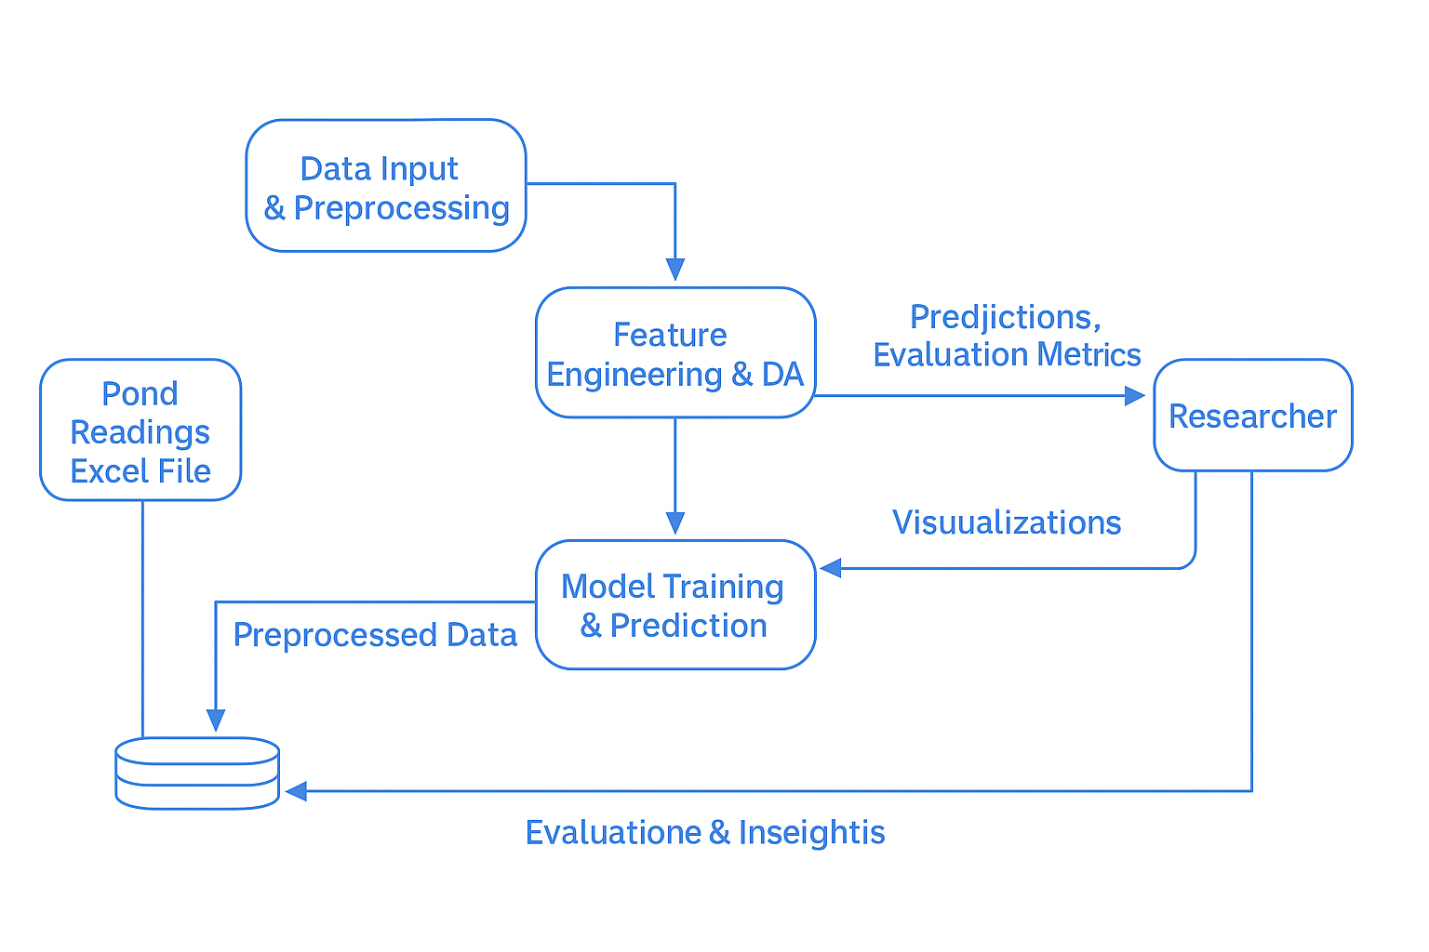
SYSTEM ARCHITECTURE
DATA FLOW DIAGRAM:
DFD, or Data Flow Diagram, serves as a graphical representation of the flow of data within a system or process.

Slide 9
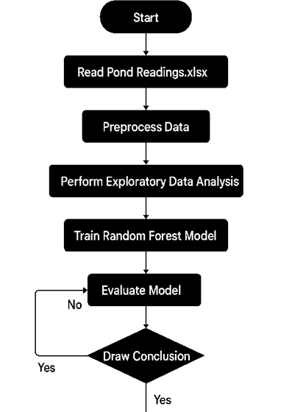
SYSTEM FLOW DIAGRAM:
An effective tool for process visualization is a System Flow Diagram (SFD), particularly in data-driven initiatives like pond water temperature prediction. It simplifies and clarifies complicated workflows by dividing them into organized steps.

Slide 10
EXPLORATORY DATA ANALYSIS
The essential first step in analyzing and summarizing datasets to comprehend their features, trends, and potential problems is called exploratory data analysis (EDA).
It uses a combination of graphical and non-graphical techniques, including univariate, bivariate, and multivariate analysis, as well as data visualization and descriptive statistics, to accomplish goals like comprehending data structure, spotting trends, identifying outliers, evaluating data quality, and directing additional analysis.

Slide 11
Correlation Analysis
Correlation analysis is used to quantify and illustrate the linear correlations between pairs of variables in a dataset, especially when a correlation matrix is created and displayed as a heatmap.
The heatmap offers a visually intuitive depiction, with color intensity reflecting the extent of association, while the correlation matrix shows correlation coefficients, which range from -1 to +1, showing the strength and direction of these relationships.
In the heatmap, significant correlations are indicated by bright color changes. These correlations imply strong linear dependencies between features, which can be important for comprehending how variables interact and guiding further modelling or analysis.

Slide 12
Time-Series Analysis
In order to observe and analyze trends of water temperature, pH, salinity, and net OD over time, time-series analysis was performed. This resulted in plots that show fluctuations and patterns that are essential for comprehending how seasonal and environmental variations affect the cultivation of spirulina.
Through the capture of the temporal history of variables and their interactions, this study seeks to discern temporal patterns, such as seasonality, cyclic variations, long-term trends, and possible outliers.
Additionally, it evaluates autocorrelation and stationarity, which eventually helps with forecasting to ensure initiative-taking reactions to sustain Spirulina development and yield by predicting future environmental changes and optimizing crop management..

Slide 13
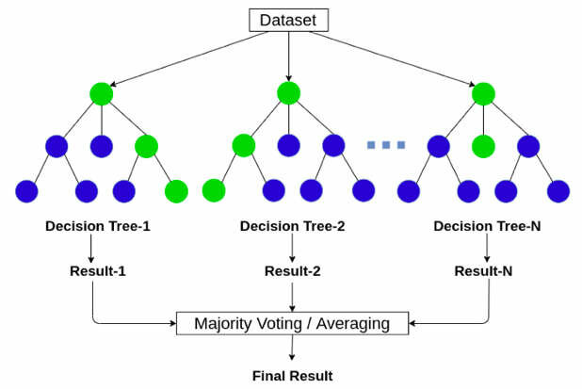
Methodologies
Random forest regression is a potent machine-learning technique that combines several decision trees into an ensemble model, allowing for precise predictions and the study of complicated datasets.
This technique reduces overfitting by employing independent decision trees, which improves generalization, and it gives high accuracy by classifying data points based on several attributes.
The algorithm is highly robust, immune to the dimensionality curse, and supports parallelization, allowing for fast processing of large datasets.

Slide 14
Future Enhancement
Enhancements can be made to the current pond water quality prediction model in the areas of data preprocessing, modelling, and deployment.
Various other graph visualization packages can also be added for the further understanding of the data. The packages are Plotly, Streamlit etc.
to successfully implement the concept, real-time user interaction can be facilitated by a web application that uses Flask, Fast API, or Streamlit. Automation through IoT-based sensors can also provide continuous monitoring, with data stored in cloud-based Firebase or NoSQL databases like MongoDB for real-time access.

Slide 15
Conclusion
This study effectively illustrated the use of machine learning techniques for pond water quality analysis and temperature prediction.
These results are particularly important for Viridia Biotech since they will improve real-time monitoring, maintain high-quality spirulina production, and optimise pond conditions.
The model's performance was good, as evidenced by its low Mean Absolute Error (MAE) and respectably high R2 score, which suggested that it was good at capturing changes in water temperature.

Slide 16
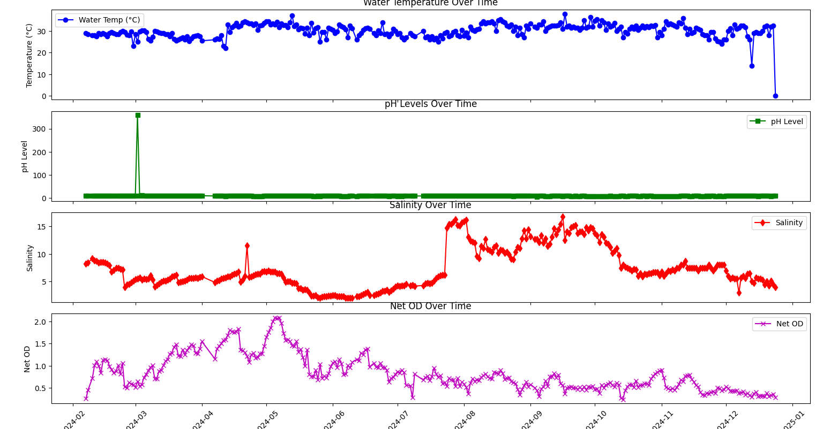
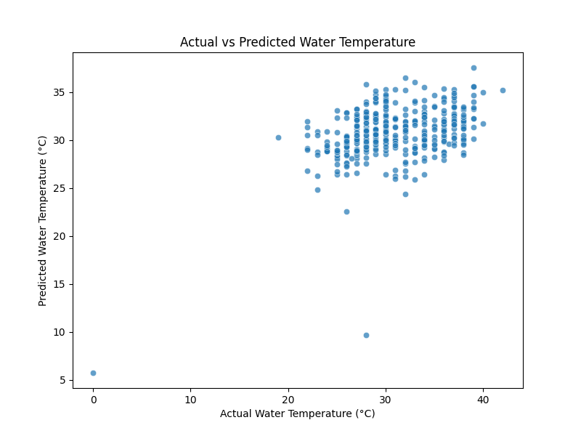
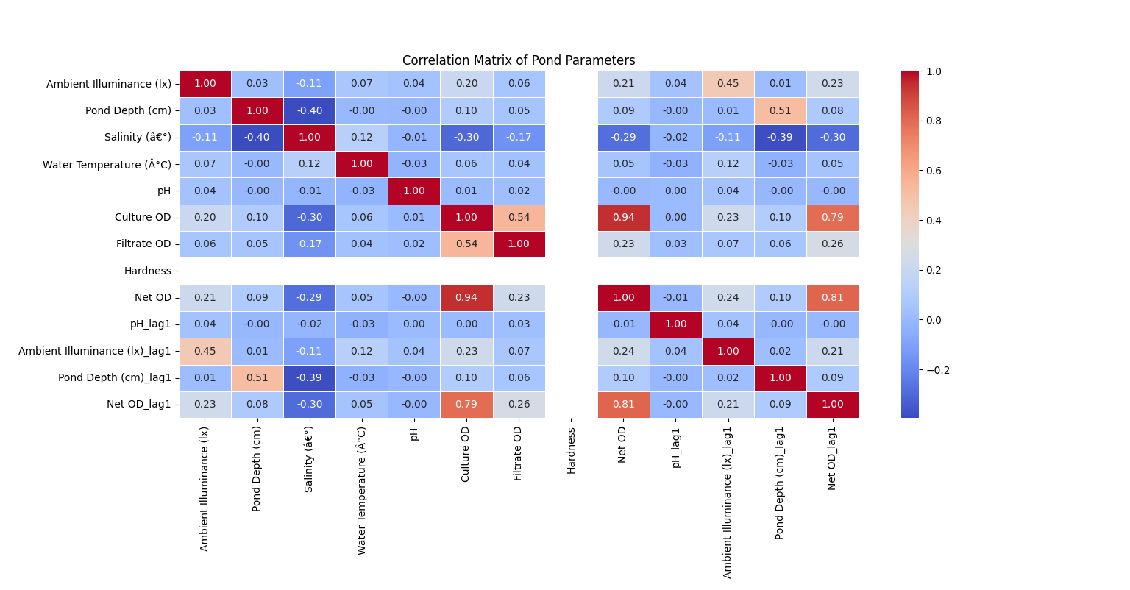
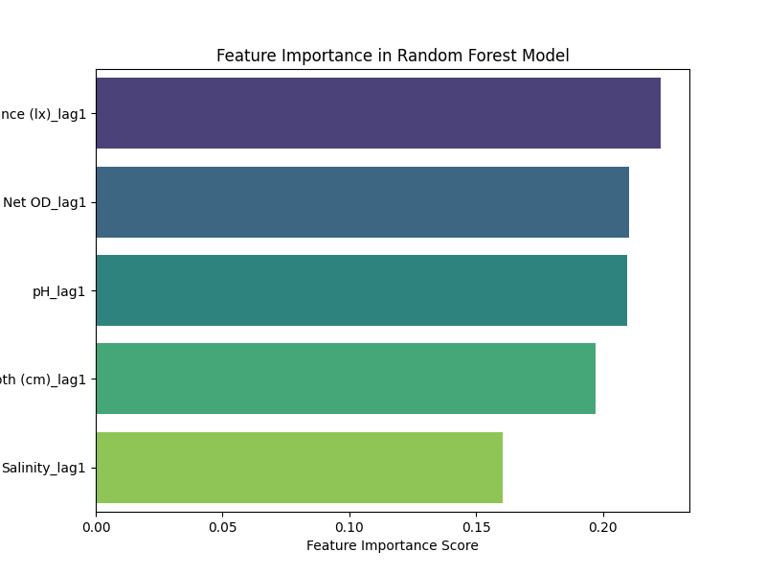
RESULTS

